Slide 1
E-Portfolio Flutter
By Stiven Röhrl & Nico Schleifnig

Slide 2
Contents
What is Flutter?
Build Process
ArchitectureAlternatives
States
Models
Tutorial/Demo

Slide 3
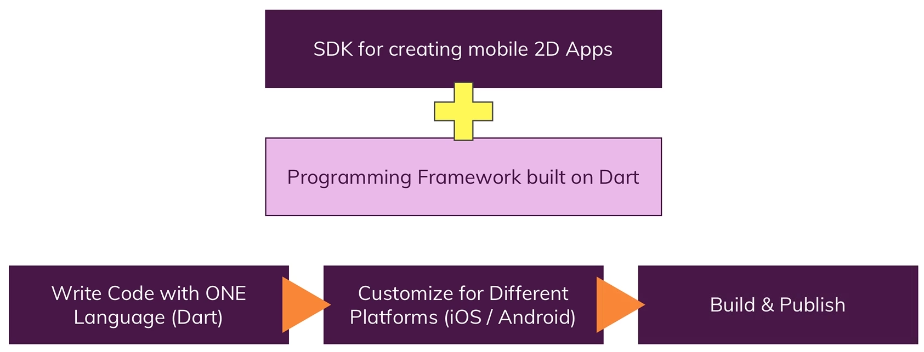
What is flutter?

Slide 4
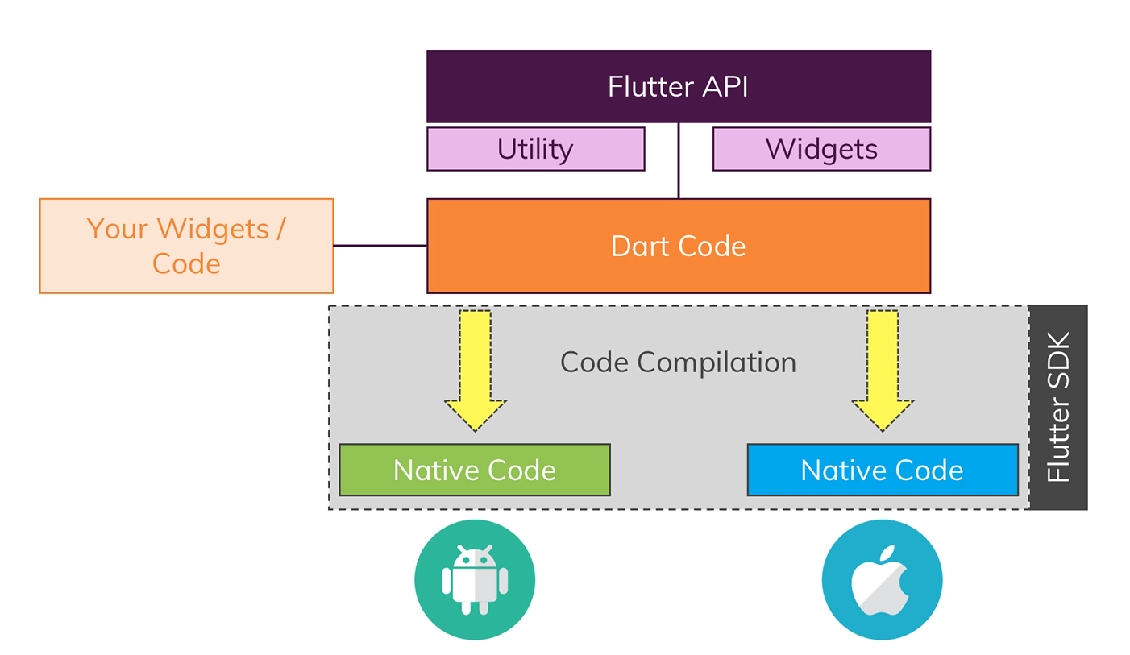
Flutter Build Process

Slide 5
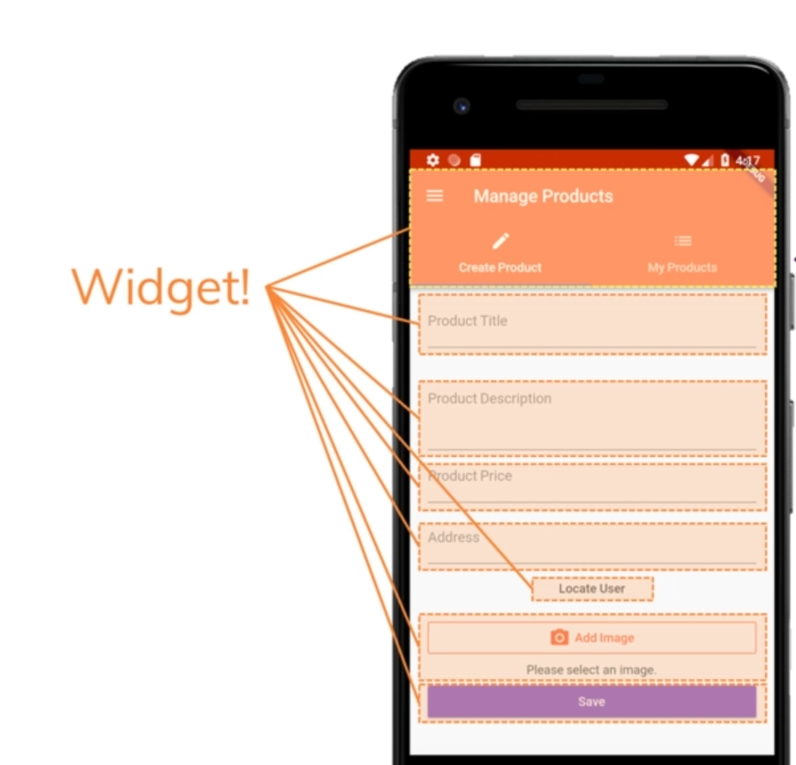
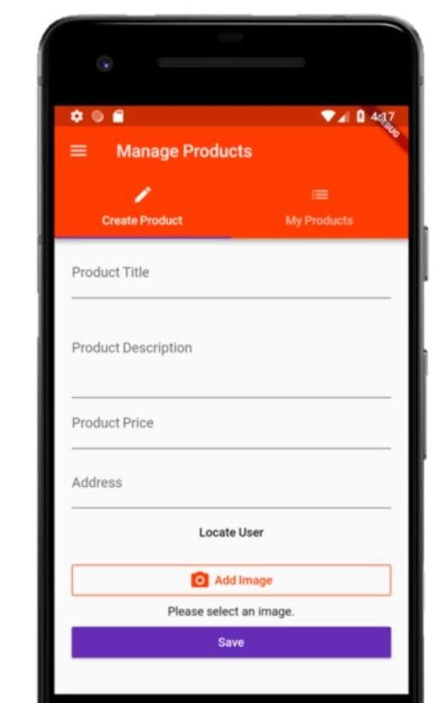
Flutter Architecture

Slide 6
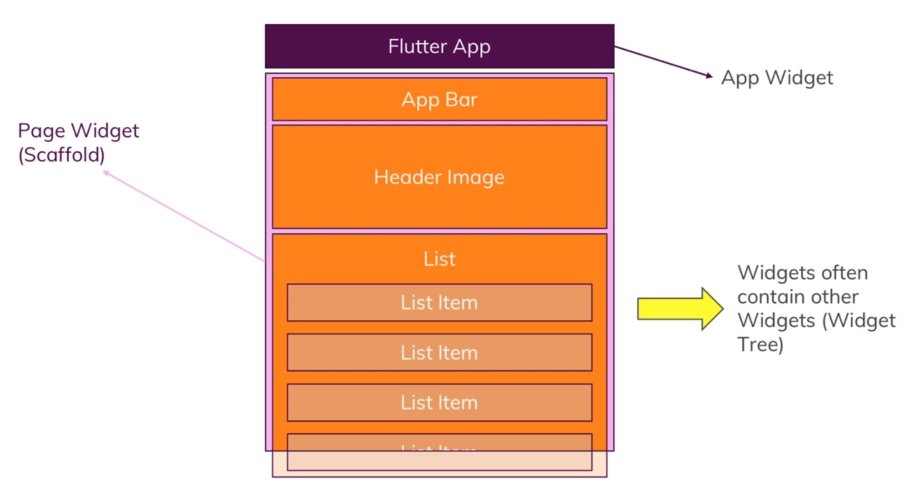
Flutter Architecture

Slide 7
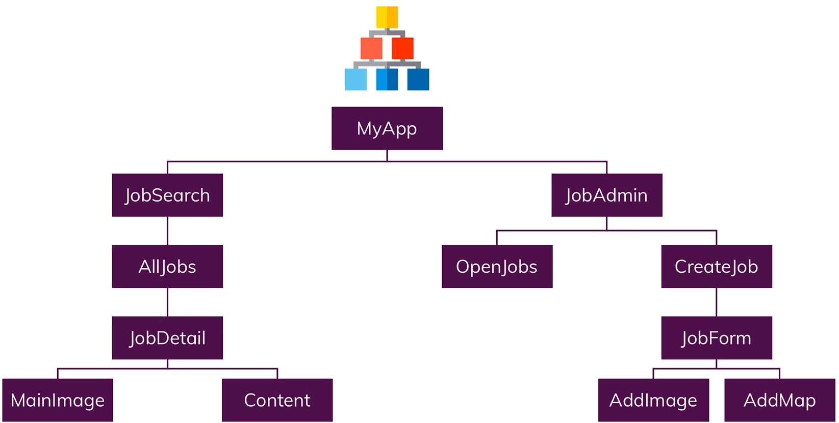
Flutter Architecture

Slide 8
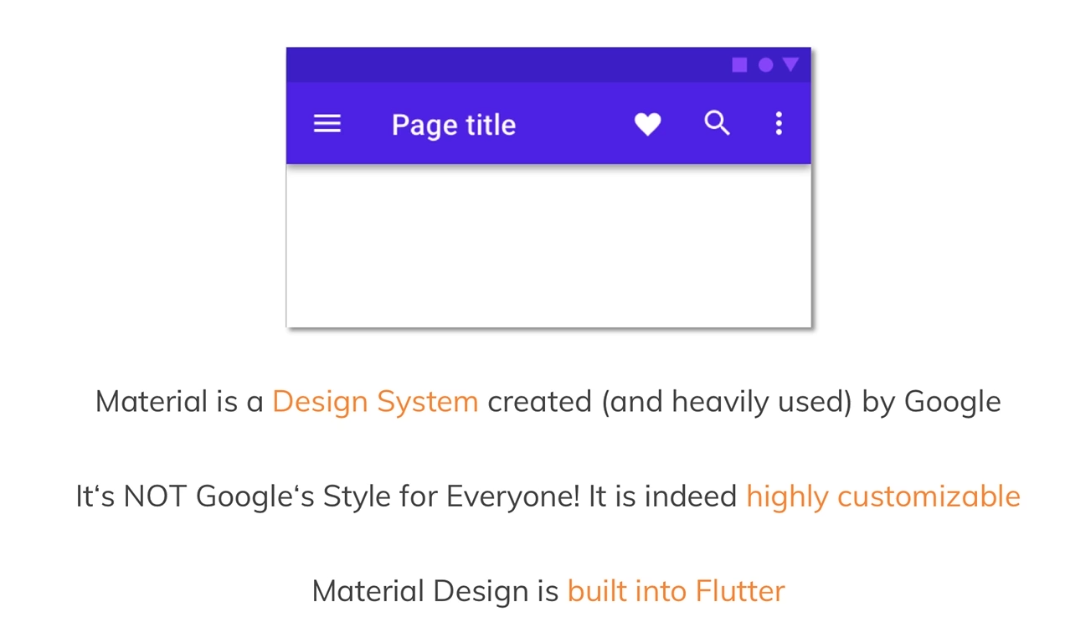
Flutter Alternatives

Slide 9
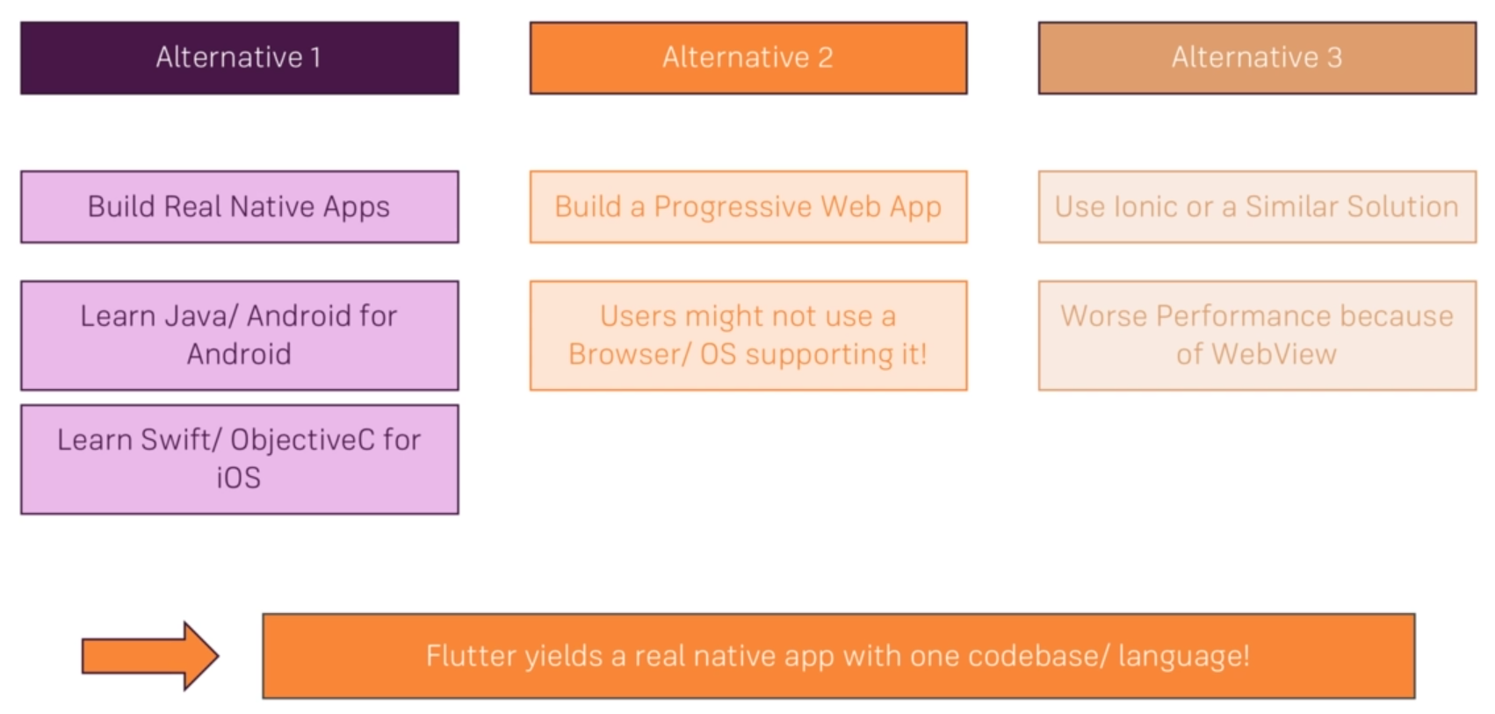
Flutter Alternatives

Slide 10
Flutter States
Stateless Widgets
Stateful Widgets

Slide 11
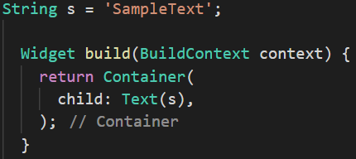
Flutter States

Slide 12
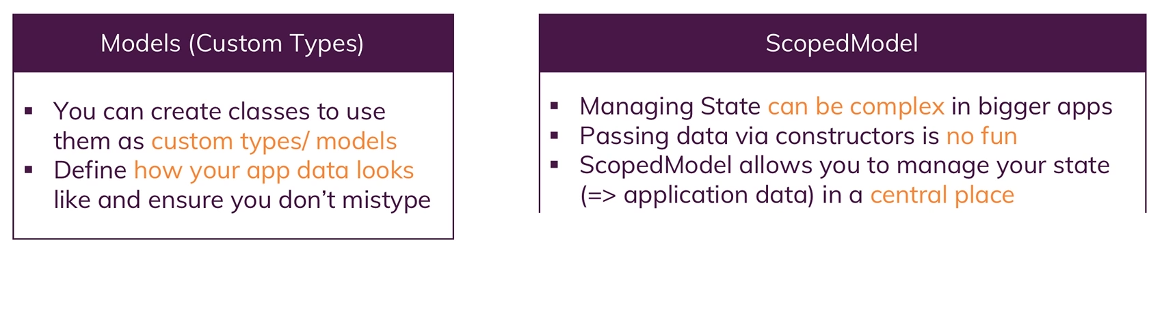
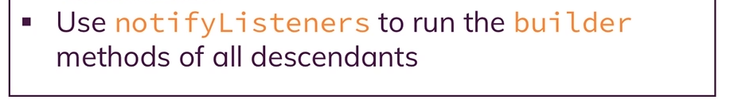
Flutter Models

Slide 13
Tutorial

